Slide 1

Regular Expressions
SoftUni Team
Technical Trainers
Software University
https://softuni.bg

Slide 2
Table of Contents
Definition
Syntax
RegEx in Python
RegEx Method
2

Slide 3
Have a Question?
sli.do
#fund-python

Slide 4

What is RegEx?

Slide 5
What is RegEx?
A regular expression or regex is a sequence of characters that define a search pattern
Usually such patterns are used by string searching algorithms for "find" or "find and replace" operations on strings
Regular expressions are used in search engines, search and replace dialogs of word processors and text editors etc
5

Slide 6
Example
For example if you want to validate if an email is valid, it should follow these rules:
have only alphanumeric characters
include "@"
end with .com/.bg/.net
To validate emails will be very difficult without regular expression
6

Slide 7
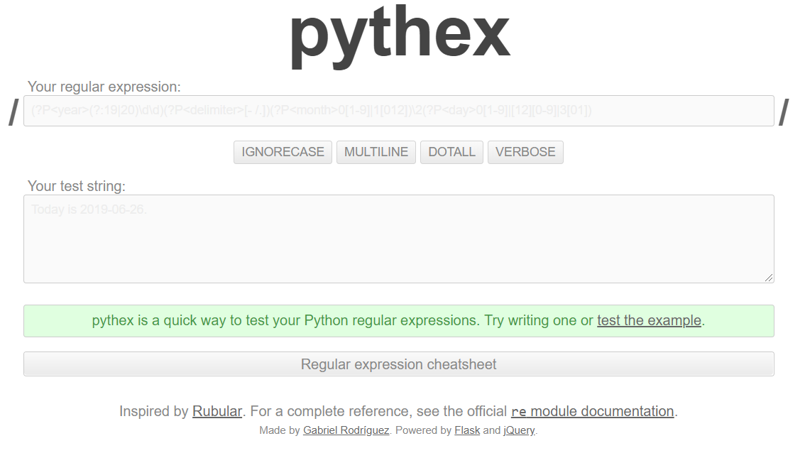
Pythex
To test Regular Expressions in Python, use pythex

Slide 8
Syntax
[A-Z]

Slide 9
Special Sequences
Notation | Meaning
\d | Returns a match where the string contains digits (numbers from 0-9)
\D | Returns a match where the string DOES NOT contain digits
\b | Returns a match where the specified characters are at the beginning or at the end of a word
\s | Returns a match where the string contains a white space character
\S | Returns a match where the string DOES NOT contain a white space character
\w | Returns a match where the string contains any word characters (characters from a to Z, digits from 0-9, and the underscore _ character)
\W | Returns a match where the string DOES NOT contain any word characters
9

Slide 10
Metacharacters
Notation | Meaning
\ | Signals a special sequence (can also be used to escape special characters)
. | Any character (except newline character)
+ | One or more occurrences
* | Zero or more occurrences
| | Either or
() | Capture and group
{} | Exactly the specified number of occurrences
^ | Starts with
$ | Ends with
10

Slide 11
Sets
Examples | Meaning
[arn] | Returns a match where one of the specified characters (a, r, or n) are present
[a-n] | Returns a match for any lower-case character, alphabetically between a and n
[^arn] | Returns a match for any character EXCEPT a, r, and n
[0123] | Returns a match where any of the specified digits (0, 1, 2, or 3) are present
[0-9] | Returns a match for any digit between 0 and 9
[0-5][0-9] | Returns a match for any two-digit numbers from 00 and 59
[a-zA-Z] | Returns a match for any character alphabetically between a and z, lower case OR upper case
11

Slide 12
RegEx in Python
import re

Slide 13
RegEx Module
Python has a built-in package called re
It can be used to work with Regular Expressions
Import the re module
Use it to search in text
import re
import re
txt = "The rain in Spain"
x = re.search("^The.*Spain$", txt)
13

Slide 14

RegEx Methods

Slide 15
Method Findall()
The findall() function returns a list containing all matches
The list contains the matches in the order they are found
If no matches are found, an empty list is returned
import re
str = "The rain in Spain"
x = re.findall("ai", str)
print(x) # ["ai", "ai"]
15

Slide 16
Problem: Match Full Name
Write a program to match full names from a list of names and print them on the console
A valid full name has the following characteristics:
It consists of two words
Each word starts with a capital letter
After the first letter, it only contains lowercase letters afterwards
Each of the two words should be at least two letters long
The two words are separated by a single space
16

Slide 17

Solution: Match Full Name
import re
names = input()
regex = "\\b[A-Z][a-z]+ [A-Z][a-z]+\\b"
matches = re.findall(regex, names)
print(" ".join(matches))
17

Slide 18
Method Search()
The search() function searches the string for a match, and returns a Match object if there is a match
If there is more than one match, only the first occurrence of the match will be returned
If no matches are found, the value None is returned
import re
str = "The rain in Spain"
x = re.search("\s", str)
print("The first white-space character is located in position:", x.start())
18

Slide 19
Problem: Match Phone Number
Write a program to match a valid phone number from Sofia. After you find all valid phones, print them on the console, separated by ", "
A valid number has the following characteristics:
It starts with "+359"
Then, it is followed by the area code (always 2)
After that, it's followed by the number itself:
The number consists of 7 digits (separated in two groups of 3 and 4 digits respectively)
The different parts are separated by either a space or a hyphen ('-')
19

Slide 20

Solution: Match Phone Number
import re
pattern = "(\+359-2-[0-9]{3}-[0-9]{4}|\+359 2 [0-9]{3} [0-9]{4})\\b"
text = input()
matches = re.findall(pattern, text)
print(", ".join(matches))
20

Slide 21

Method Split()
The split() function returns a list where the string has been split at each match
import re
str = "The rain in Spain"
x = re.split("\s", str)
print(x)
# ['The', 'rain', 'in', 'Spain']
21

Slide 22
Problem: Match Dates
Write a program, which matches a date in the format "dd{separator}MMM{separator}yyyy"
Use capturing groups in your regular expression
13/Jul/1928, 10-Nov-1934, , 01/Jan-1951,f 25.Dec.1937 23/09/1973, 1/Feb/2016
Day: 13, Month: Jul, Year: 1928 Day: 10, Month: Nov, Year: 1934 Day: 25, Month: Dec, Year: 1937
22

Slide 23
Solution: Match Dates
import re
pattern = "\\b(?P<day>\\d{2})([-.\\/])(?P<month>[A-Z] [a-z]{2})\\2(?P<year>\\d{4})\\b"
text = input()
matches = re.finditer(pattern, text)
for match in matches:
print(f"Day: {match.group('day')}, Month: {match.group('month')}, Year: {match.group('year')}")
23

Slide 24

Live Exercises

Slide 25

Summary
A regular expression or regex is a sequence of characters that define a search pattern
Python has a built-in package called re
It can be used to work with Regular Expressions
…
…
…

Slide 26
Questions?
Notes:
26

Slide 27











SoftUni Diamond Partners

Slide 28


Educational Partners

Slide 29
Trainings @ Software University (SoftUni)
Software University – High-Quality Education, Profession and Job for Software Developers
softuni.bg, softuni.org
Software University Foundation
softuni.foundation
Software University @ Facebook
facebook.com/SoftwareUniversity
Software University Forums
forum.softuni.bg
29
Notes:
29

Slide 30

License
This course (slides, examples, demos, exercises, homework, documents, videos and other assets) is copyrighted content
Unauthorized copy, reproduction or use is illegal
© SoftUni – https://softuni.org
© Software University – https://softuni.bg
Notes:
30

